Slide 1



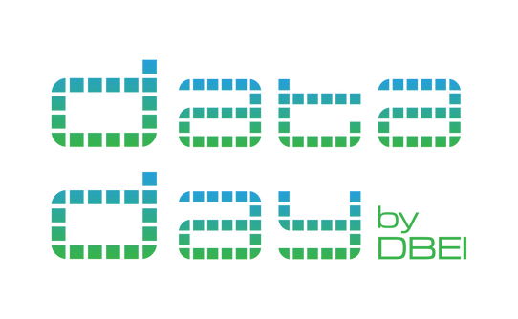




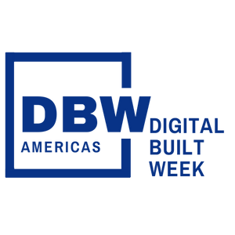

How We Leveraged Data to Overcome Resistance to Investment in Automation
Company Logo
Matt Collier
Michael Kilkelly
John Cook
DIGITAL BUILT WEEK AMERICAS
JUNE 15-17, 2023 | DALLAS, TEXAS

Slide 2
Digital Built Week Americas 2022
___________________________________________
Questions related to specific materials, methods, and services will be addressed at the conclusion of this presentation.
DIGITAL BUILT WEEK AMERICAS
JUNE 15-17, 2023 | DALLAS, TEXAS

Slide 3
Session Description
Over the past few years, IMEG has grown its automation capabilities from a handful of Dynamo graphs to a full-fledged software development team. The cornerstone of this growth is usage data. In this presentation, we will discuss how we collected and leveraged this data to convince leadership to invest heavily in custom tools and build a team dedicated to supporting this effort.
Learning Objectives
At the end of this session, participants will be able to:
Describe the importance of collecting usage data at any stage of your automation journey
Formulate a plan for what data to collect
Understand how to calculate the impact of your custom tools
Understand strategies for collecting usage data
Understand how to get started with visualizing usage data
Additional Handouts On GitHub
DIGITAL BUILT WEEK AMERICAS
JUNE 15-17, 2023 | DALLAS, TEXAS

Slide 4


IMEG’s Automation Journey:
John Cook
DIGITAL BUILT WEEK AMERICAS
JUNE 15-17, 2023 | DALLAS, TEXAS

Slide 5



IMEG’s Automation Journey:
Michael Kilkelly
DIGITAL BUILT WEEK AMERICAS
JUNE 15-17, 2023 | DALLAS, TEXAS

Slide 6

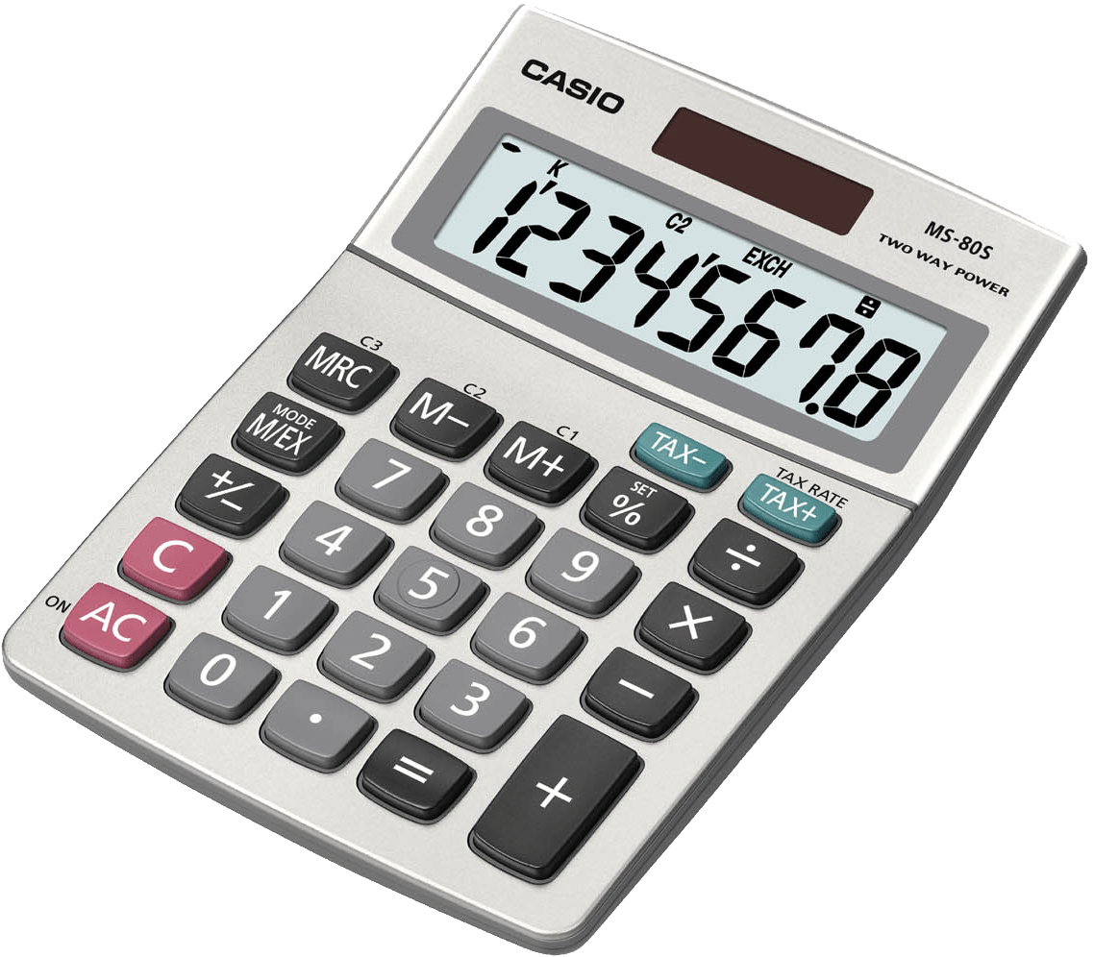

IMEG’s Automation Journey:
Matt Collier
DIGITAL BUILT WEEK AMERICAS
JUNE 15-17, 2023 | DALLAS, TEXAS
This Photo by Unknown Author is licensed under CC BY-SA

Slide 7

IMEG’s Automation Journey:
Forming a team
2020
Matt and his team had just released their first electrical plugin
John and Michael had several plugins created and ready to go
Combined efforts to create a single IMEG toolbar and rolled it out to the organization
2021
Officially created product ownership team
Officially created a development team
Michael joined IMEG full-time as a product owner
2022 - Today
We have four product owner, four developers, and
the team is growing
Building several new tools per year
DIGITAL BUILT WEEK AMERICAS
JUNE 15-17, 2023 | DALLAS, TEXAS

Slide 8

Obstacles Blocking Automation Growth:
Leadership resistant to new investment
Resistance to change
Perceived financial risk
Desire for hard data
Justification of new costs at each step
Proving value of existing portfolio
Projecting value of new tools
DIGITAL BUILT WEEK AMERICAS
JUNE 15-17, 2023 | DALLAS, TEXAS

Slide 9
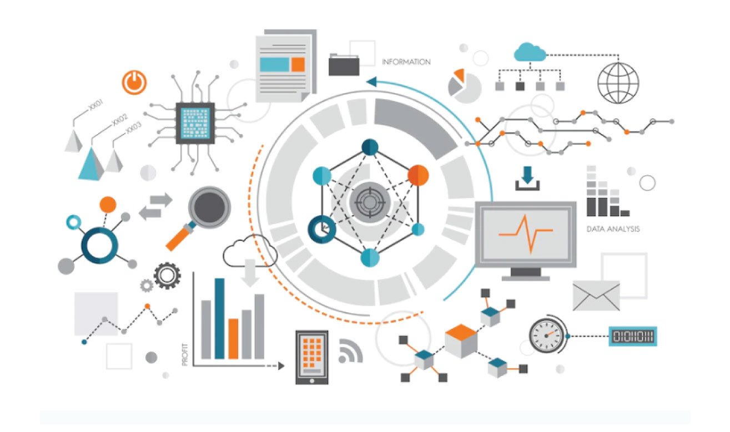
Quantifying the Impact Through Data is Crucial!
DIGITAL BUILT WEEK AMERICAS
JUNE 15-17, 2023 | DALLAS, TEXAS

Slide 10




Our Data Collection Journey:
Rough Estimates
Slack
Data Lake
DIGITAL BUILT WEEK AMERICAS
JUNE 15-17, 2023 | DALLAS, TEXAS

Slide 11
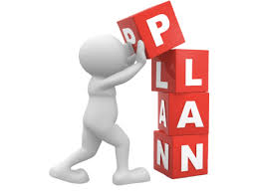
Planning for data collection:
Data to collect
What story are you telling at each stage?
Quantifying the time saved
Quantifying the area of opportunity
DIGITAL BUILT WEEK AMERICAS
JUNE 15-17, 2023 | DALLAS, TEXAS

Slide 12
Clicks / Usage
Actions Per Click
Projects Being Worked On
Data to Collect
DIGITAL BUILT WEEK AMERICAS
JUNE 15-17, 2023 | DALLAS, TEXAS

Slide 13

Clicks / Usage
Data to Collect: Clicks / Usage
In the beginning this may be enough
What story are you telling at this stage?
Who used the tool?
Name
Role
Team
What project was the tool used on?
Project number
Project name
DIGITAL BUILT WEEK AMERICAS
JUNE 15-17, 2023 | DALLAS, TEXAS

Slide 14

Actions Per Click
Data to Collect: Actions Per Click
Basic clicks/usage data is no longer enough, the story now needs more detail
What story are you telling at this stage?
Not all clicks have equal value
By quantifying exactly what the tool does in each usage, you can better understand the impact
DIGITAL BUILT WEEK AMERICAS
JUNE 15-17, 2023 | DALLAS, TEXAS

Slide 15

Projects Being Worked On
Data to Collect: Projects Being Worked On
You already have a great story proving your tools are being used, and what value they provide, but could the impact be greater?
What story are you telling at this stage?
By understanding what projects are actively being opened and worked on, we can understand utilization rates
This will also help us understand the area of opportunity
DIGITAL BUILT WEEK AMERICAS
JUNE 15-17, 2023 | DALLAS, TEXAS

Slide 16



Quantifying the Time Saved Per Usage or Action
Assumptions
Surveys
Time Studies
DIGITAL BUILT WEEK AMERICAS
JUNE 15-17, 2023 | DALLAS, TEXAS

Slide 17
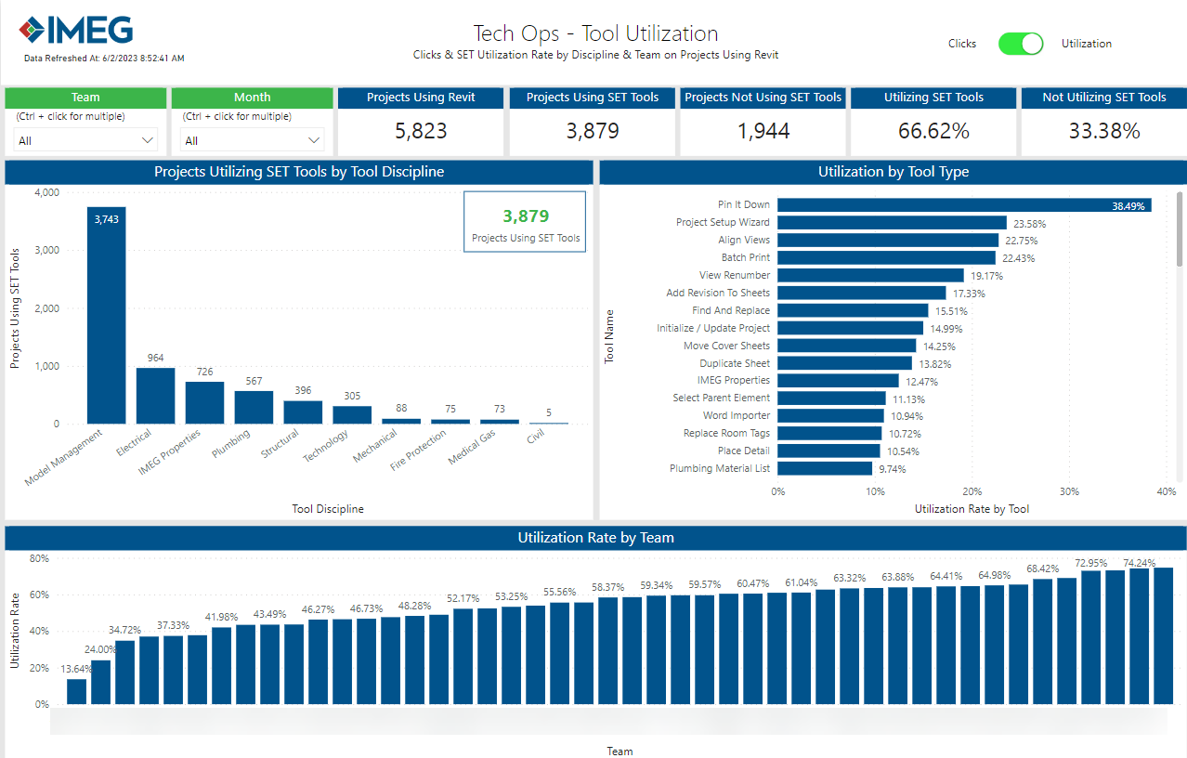
Quantifying the Area of Opportunity
Utilization rates
How many projects are using tools compared to how many are being worked on?
DIGITAL BUILT WEEK AMERICAS
JUNE 15-17, 2023 | DALLAS, TEXAS

Slide 18
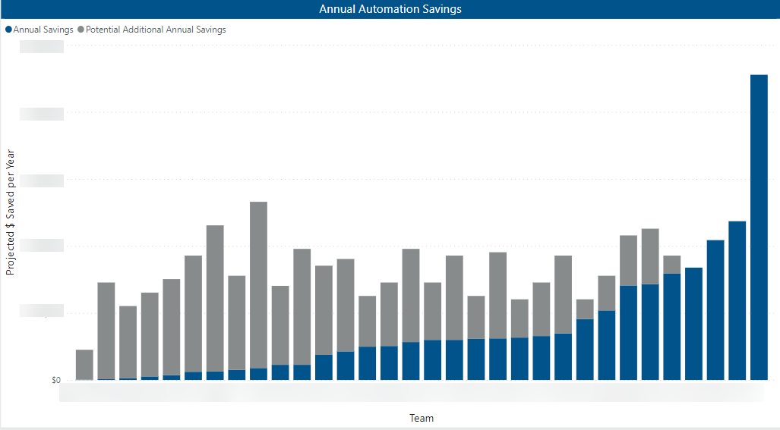
Quantifying the Area of Opportunity
Set a benchmark
We use average time saved per full time employee for the top 1/3 of teams
Project that benchmark on all teams based on team size to compare actual time saved to the benchmark
DIGITAL BUILT WEEK AMERICAS
JUNE 15-17, 2023 | DALLAS, TEXAS

Slide 19
Collecting Data: Method 1: Webhook to Existing Messaging Platform
Create Slack workspace and channels for your data https://slack.com/
Enable incoming webhooks in your workspace https://api.slack.com/messaging/webhooks
Add webhook call to your plugin or Dynamo script
C# example https://gist.github.com/jogleasonjr/7121367
Dynamo example https://radumg.github.io/DynaSlack/
Export messages to CSV file using “/export” command in Slack
DIGITAL BUILT WEEK AMERICAS
JUNE 15-17, 2023 | DALLAS, TEXAS

Slide 20
Collecting Data: Method 1: Webhook to Existing Messaging Platform
Pros:
Easy Implementation: Implementing the webhook to a messaging platform like Slack is relatively straightforward and requires minimal coding.
Real-Time Access: With the webhook, usage data can be accessed and monitored in real time, providing immediate insights into add-in usage.
Cons:
Data Extraction Challenges: While real-time access to user data is beneficial, extracting and manipulating aggregated data from the messaging platform can be cumbersome. Using commands like "/export" in Slack to export message data may require additional data manipulation and analysis steps.
DIGITAL BUILT WEEK AMERICAS
JUNE 15-17, 2023 | DALLAS, TEXAS

Slide 21
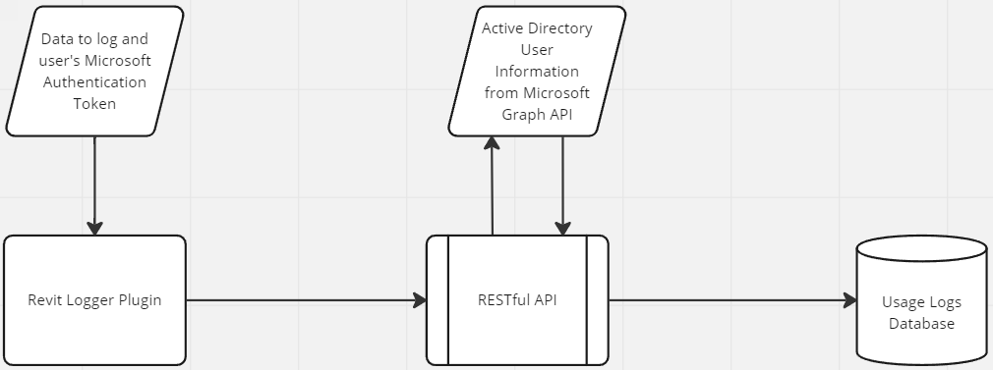
Collecting Data: Method 2: Log to Database Using Custom RESTful API
DIGITAL BUILT WEEK AMERICAS
JUNE 15-17, 2023 | DALLAS, TEXAS

Slide 22
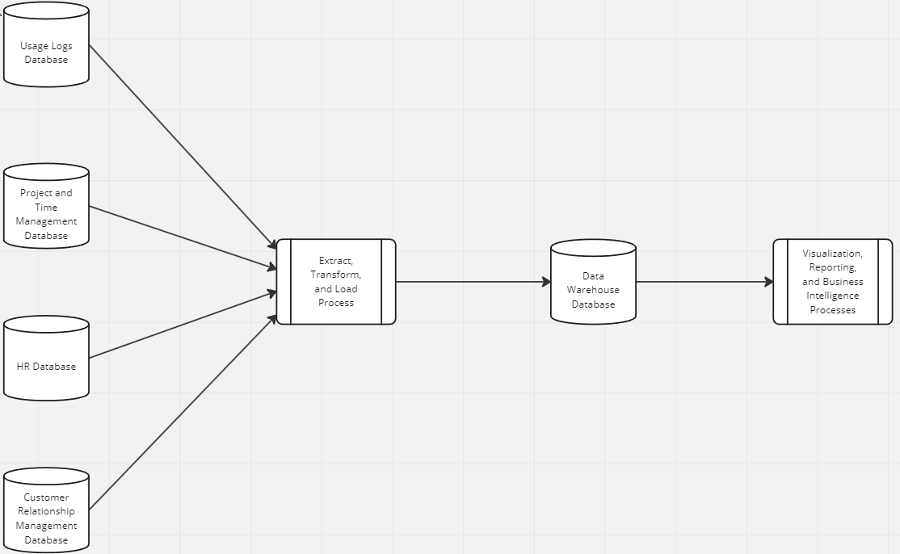
Collecting Data: Method 2: Log to Database Using Custom RESTful API
DIGITAL BUILT WEEK AMERICAS
JUNE 15-17, 2023 | DALLAS, TEXAS

Slide 23
Collecting Data: Method 2: Log to Database Using Custom RESTful API
Pros:
Easy Data Extraction: Logging data directly to a database simplifies extracting and analyzing the collected information. Data can be easily queried and manipulated for further analysis and reporting.
Incorporation of User-Specific Data: By leveraging the Microsoft Graph API, user-specific data from Active Directory can be seamlessly integrated into the database, providing deeper insights into user behavior and add-in usage patterns.
Cons:
Implementation Complexity: Compared to the webhook method, setting up a custom RESTful API and database integration requires more technical expertise and effort during the implementation phase.
DIGITAL BUILT WEEK AMERICAS
JUNE 15-17, 2023 | DALLAS, TEXAS

Slide 24
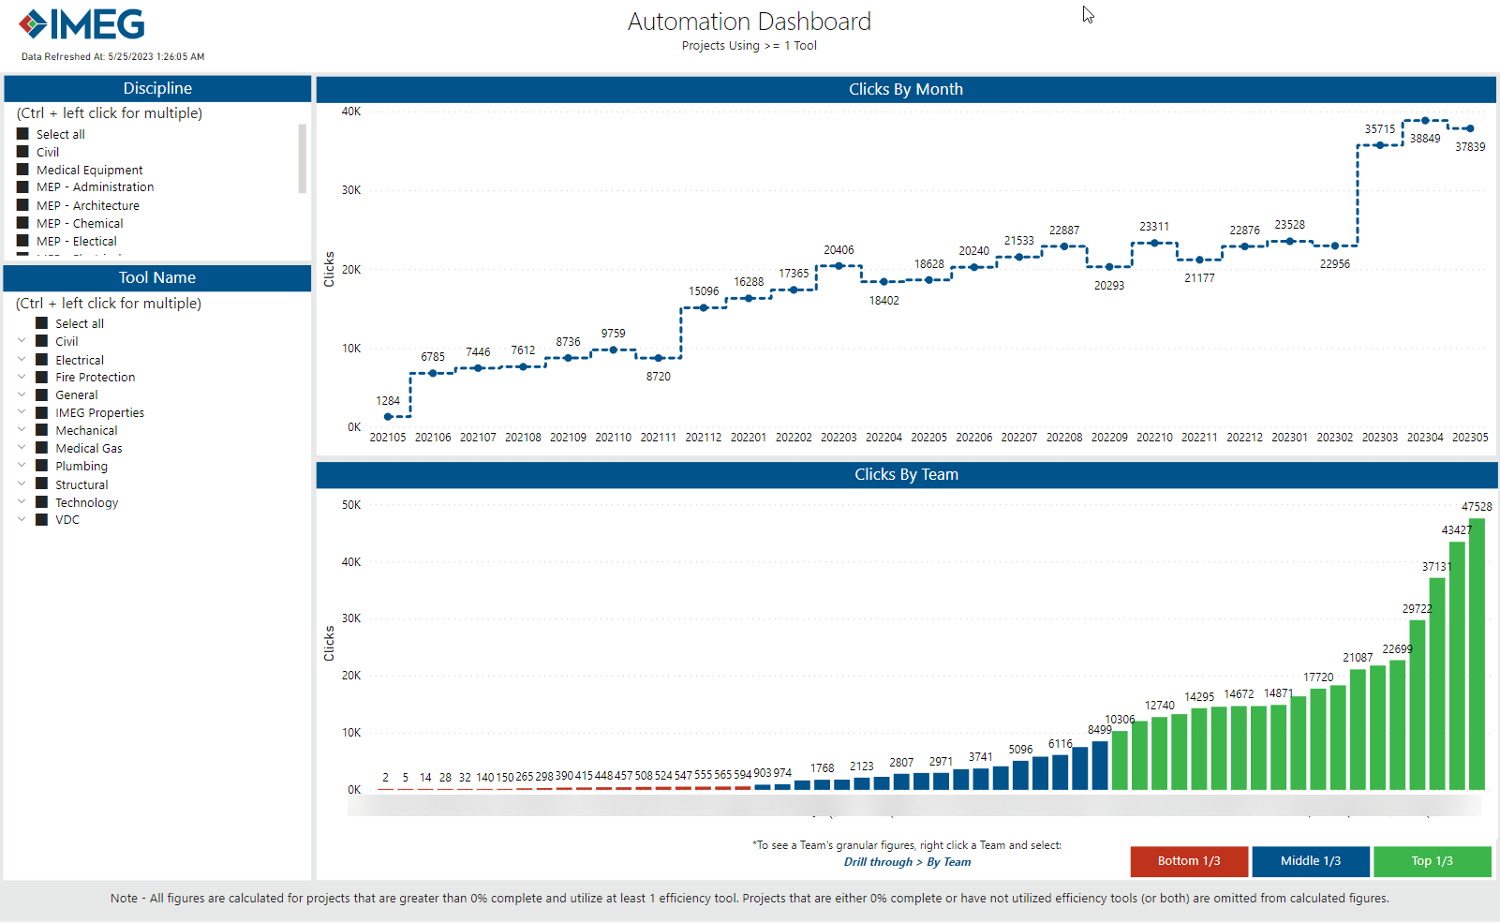
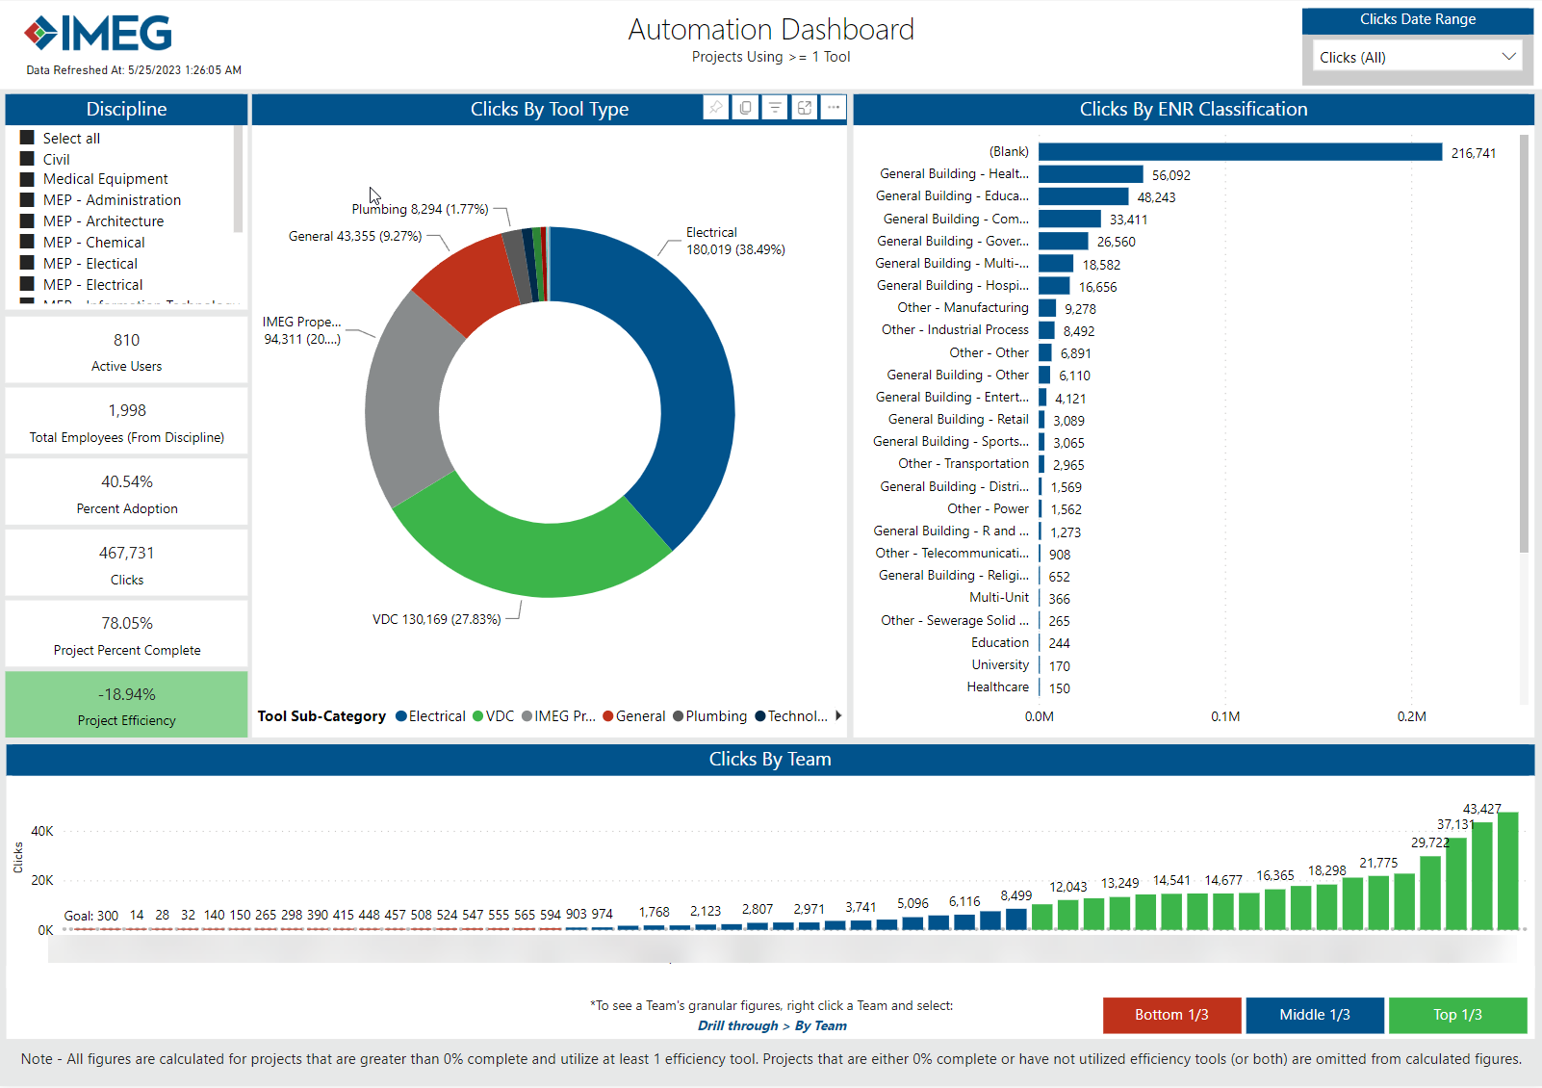


Visualizing Usage Data: Microsoft Power BI
DIGITAL BUILT WEEK AMERICAS
JUNE 15-17, 2023 | DALLAS, TEXAS

Slide 25
Visualizing Usage Data: Microsoft Power BI
Getting started with Power BI
https://powerbi.microsoft.com/en-us/getting-started-with-power-bi/
Add data sources
https://learn.microsoft.com/en-us/training/modules/get-data-power-bi/3-connect-data-sources-power-bi-desktop
Add visuals to your report
https://learn.microsoft.com/en-us/training/modules/visuals-in-power-bi/
Publish your report
https://learn.microsoft.com/en-us/training/modules/publish-share-power-bi/
DIGITAL BUILT WEEK AMERICAS
JUNE 15-17, 2023 | DALLAS, TEXAS

Slide 26
Conclusion:
To demonstrate value, you must tell a compelling story that quantifies impact
The story will evolve in multiple stages
Identify the story you are telling
Plan what data to collect
Plan how to collect the data
Create visuals to illustrate the story
DIGITAL BUILT WEEK AMERICAS
JUNE 15-17, 2023 | DALLAS, TEXAS

Slide 27
Reminder
Speaker and Session Feedback is Appreciated
Go to Sessions
Select this Session
Select Session Rating
How We Leveraged Data to Overcome Resistance to Investment in Automation Session 3.3
Matthew Collier, IMEG | Michael Kilkelly, IMEG | John Cook, IMEG
DIGITAL BUILT WEEK AMERICAS
JUNE 15-17, 2023 | DALLAS, TEXAS

Slide 28
Visit me at the Speaker Lounge
We will be at the Speaker Lounge outside the Exhibition Hall for further conversations. Please join me there at this time:
(Your confirmed date and time here)
DIGITAL BUILT WEEK AMERICAS
JUNE 15-17, 2023 | DALLAS, TEXAS

Slide 29
Questions?
How We Leveraged Data to Overcome Resistance to Investment in Automation
Matthew Collier, IMEG | Michael Kilkelly, IMEG | John Cook, IMEG
DIGITAL BUILT WEEK AMERICAS
JUNE 15-17, 2023 | DALLAS, TEXAS

